Slide 1
Linear Regression

Slide 2
Definition
In linear regression, the relationships are modeled using linear predictor functions whose unknown model parameters are estimated from the data.
In linear regression, the relationships are modeled using linear predictor functions whose unknown model parameters are estimated from the data.

Slide 3
Equation
A linear regression line has an equation of the form Y = a + bX, where X is the explanatory variable and Y is the dependent variable. The slope of the line is b, and a is the intercept (the value of y when x = 0).

Slide 4
Examples
Crop yields on rainfall : Yield is Dependent variable (Nothing but Output which we forecast), Rainfall is explanatory variable.
Products on sales: Sales are explanatories
Marks on activities : Marks is dependent and activities explanatory

Slide 5
Pros
Linear regression is an extremely simple method. It is very easy and intuitive to use and understand.
A person with only the knowledge of high school mathematics can understand and use it.
It works in most of the cases.
Even when it doesn’t fit the data exactly, we can use it to find the nature of the relationship between the two variables.
the best fit line is the line with minimum error from all the points ,it has high efficiency but sometimes this high efficiency

Slide 6
Cons
It assumes there is a straight-line relationship between them which is incorrect sometimes.
Linear regression is very sensitive to the anomalies in the data (or outliers).
If we have a number of parameters than the number of samples available then the model starts to model the noise rather than the relationship between the variables.

Slide 7
Naive Bayes

Slide 8
Definition
It is a classification algorithm.
Naive Bayes theorem works on conditional probability
The fundamental Naive Bayes assumption is that each feature makes an independent equal contribution to the outcome.
Despite its simplicity, Naive Bayes can often outperform more sophisticated classification methods.
Naive Bayes classifier gives great results when we use it for textual data analysis. Such as Natural Language Processing.

Slide 9
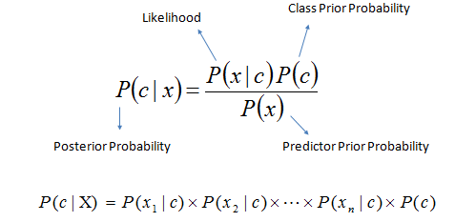
Equation
Bayes theorem provides a way of calculating the posterior probability, P(c|x), from P(c), P(x), and P(x|c). Naive Bayes classifier assume that the effect of the value of a predictor (x) on a given class (c) is independent of the values of other predictors. This assumption is called class conditional independence.

Slide 10
Examples
To mark an email as spam, or not spam ?
Classify a news article about technology, politics, or sports ?
Check a piece of text expressing positive emotions, or negative emotions?
Also used for face recognition software.

Slide 11
Pros
Very simple, easy to implement and fast.
Need less training data.
Highly scalable. It scales linearly with the number of predictors and data points.
Can be used for both binary and multi-class classification problems.
Not sensitive to irrelevant features.
Handles continuous and discrete data.

Slide 12
Cons
It makes a very strong assumption on the shape of your data distribution, i.e. any two features are independent given the output class. Due to this, the result can be (potentially) very bad - hence, a “naive” classifier.
Another problem happens due to data scarcity. For any possible value of a feature, you need to estimate a likelihood value by a frequentist approach. This can result in probabilities going towards 0 or 1, which in turn leads to numerical instabilities and worse results.
A third problem arises for continuous features. It is common to use a binning procedure to make them discrete, but if you are not careful you can throw away a lot of information.

